Slide 1
Personal Psychiatrist
Sweta Leena
1NH19CS750

Slide 2
Agenda
Abstract
Introduction
Problem Definition
Methodology
Modules
Features
Layout Screen
8. Conclusion

Slide 3
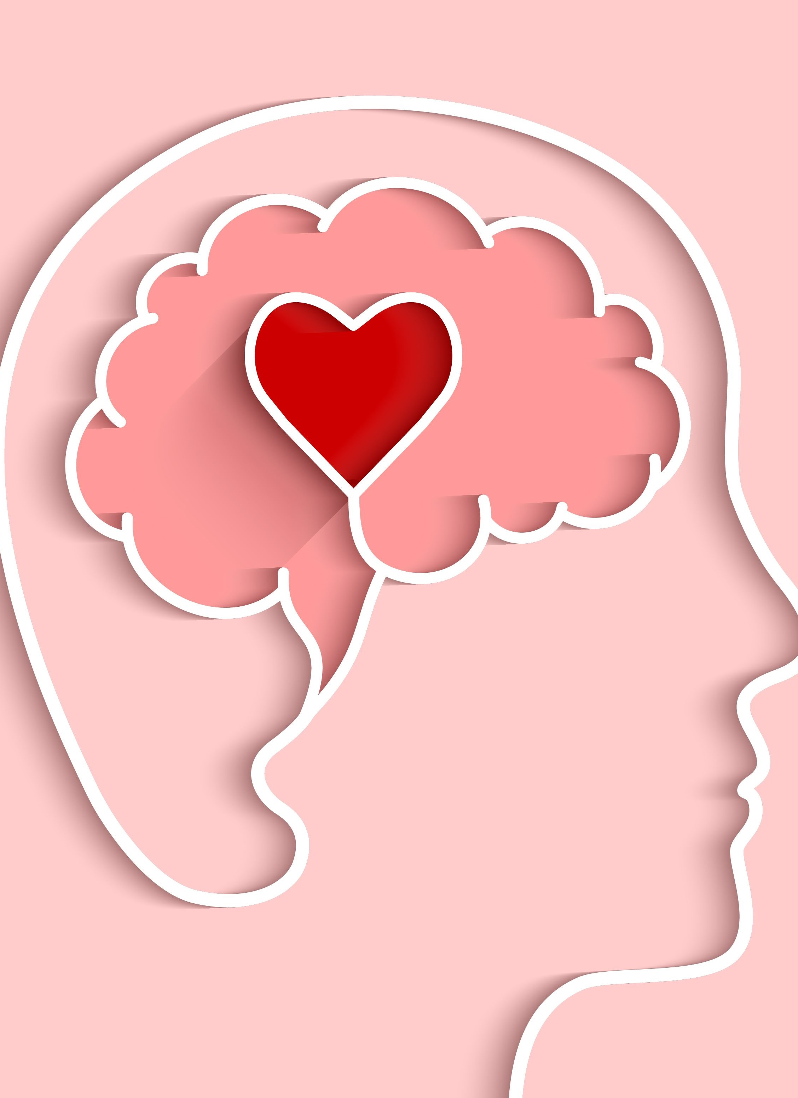
Abstract
The smart phone can be used to recognize mental health and will be able to analyze it. It can help to monitor it too. The app is used for leman users who can use it without having knowledge regarding mobile app development​

Slide 4
INTRODUCTION
In this world the mental health issue is a real time issue and it is leading towards deadly world where people can’t decide through what they are going through but if they could analyze it through some way which is cost free and easily available they can take the medication early.

Slide 5
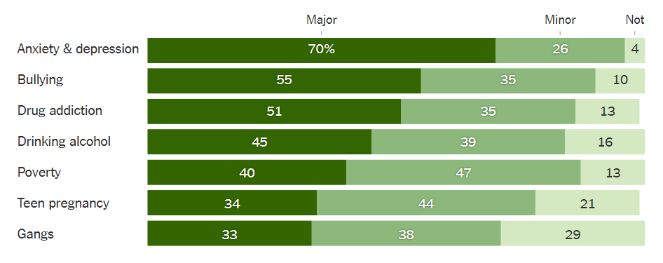
Problem Definition
This is the analysis of mental health in 2020 what causes the mental health issue and how it affect so many people.
This chat shows what is the percentage of getting mental health issue by what habit.
But if someone would get to know this from before itself then it would be easy for user to control it.

Slide 6
Methodology
Step1:-Registration page The registration page is different than usual registration page here it will ask user to give a nick name to them selves and by this way the user can be connected. And users’ personal details won’t be revealed.
Step2: - Home page The user will get all the options to connect other different pages. It contains: - Path which connects to Gratitude and blog page. Personal Assessment page which further leads to analysis page Mood tracker Doctors’ details
Step3: - Find balance It contains Gratitude page which will give users to write their gratitude. And based on the date it will save the data in data base.
Step4: - Assessment page In assessment page it will ask user situation-based questions and then based on the answer it prepares the analysis page.
Step5: - Doctors details In doctors details it gives details regarding doctors where the user can call to the doctor and will be able to connect with doctor for further consultancy.
Step 6: - Mood tracker Mod tracker, which will save the mood based on the date.

Slide 7
MODULE
Registration page
Home page
Assessment and analysis page
Doctor Information
Gratitude and mental health info
Mood Tracker page

Slide 8
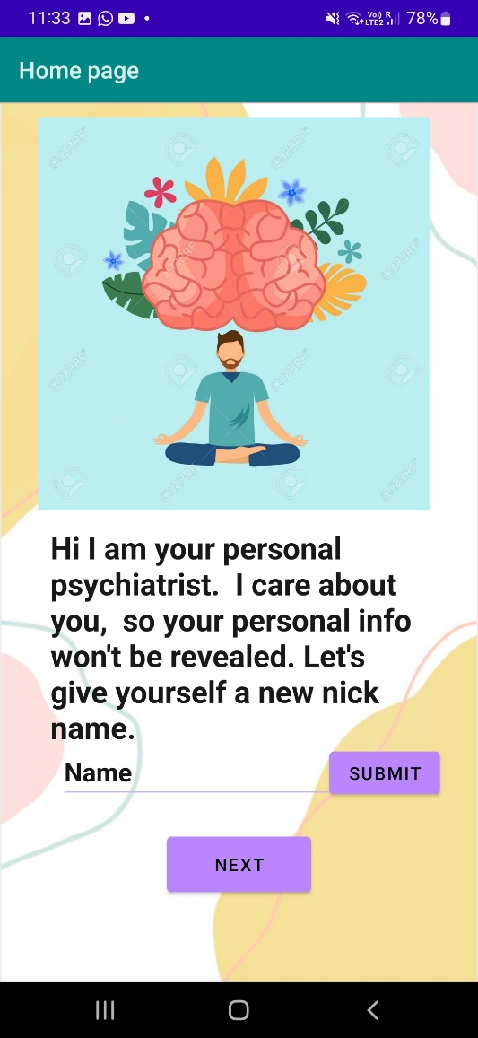
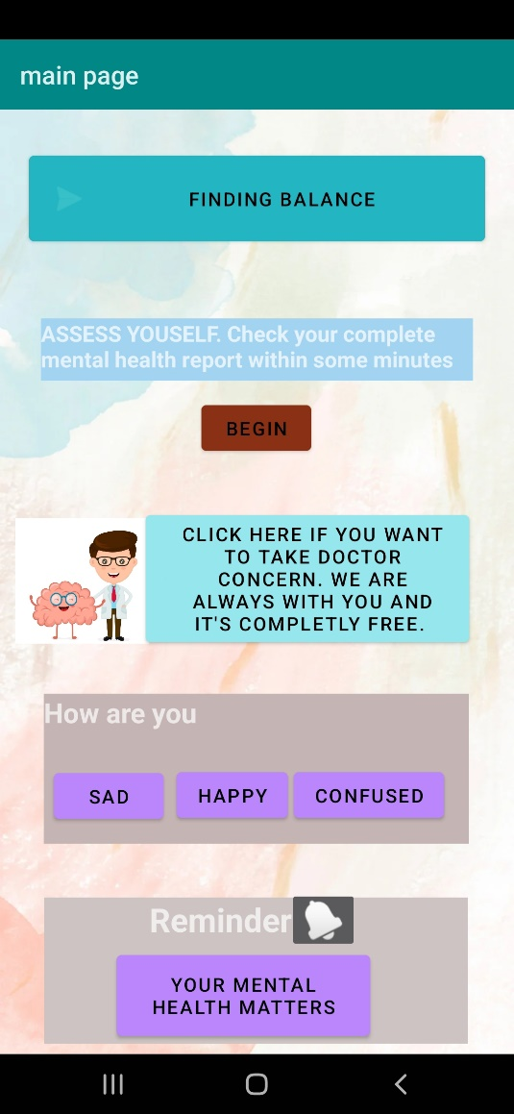
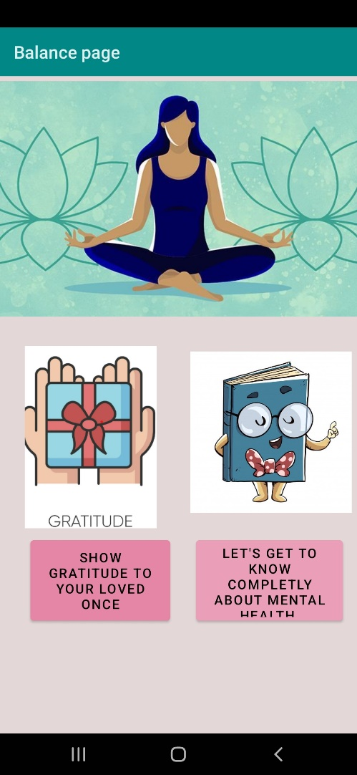
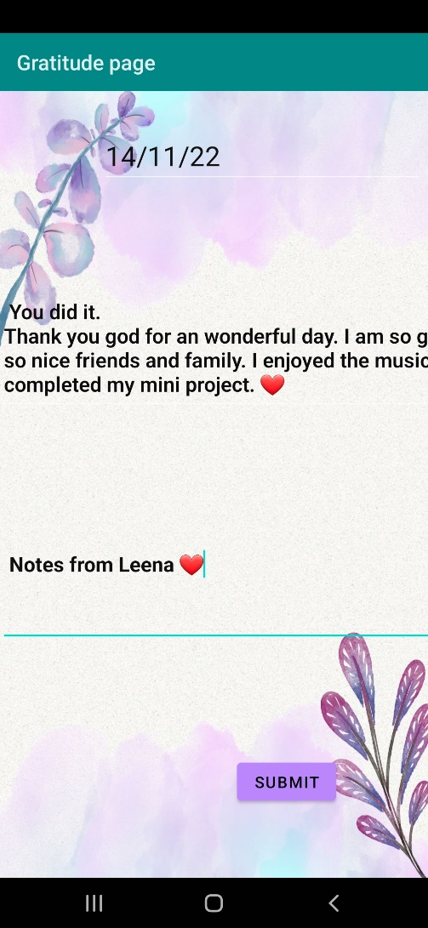
Layout Screens
homepage
Main Page
Find Balance Page
Gratitude Page

Slide 9
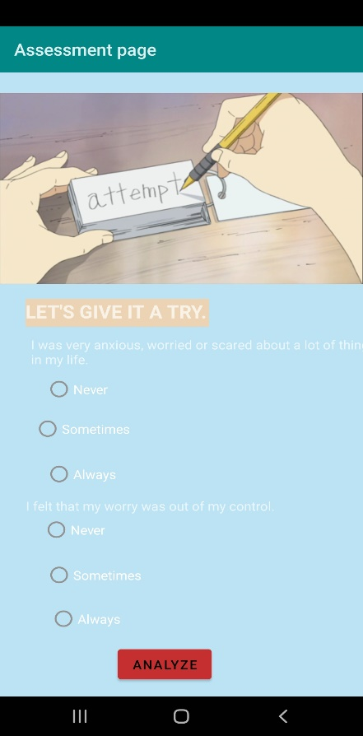
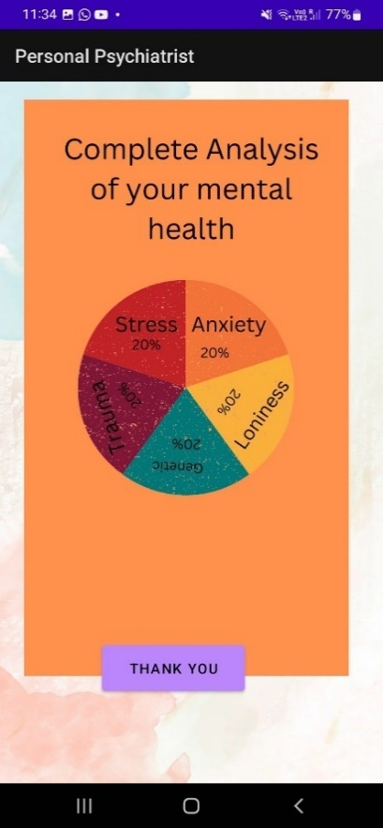
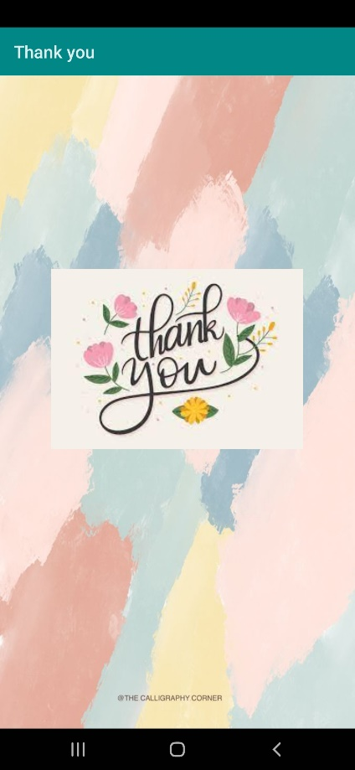
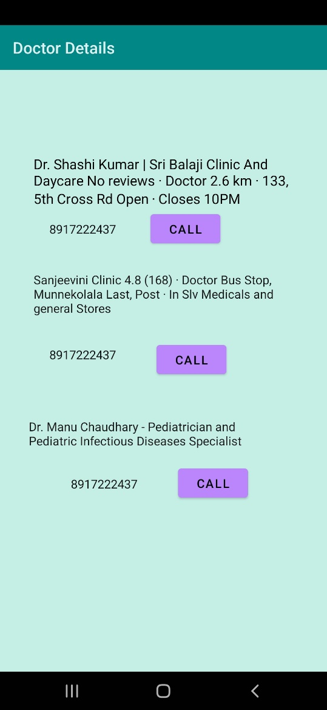
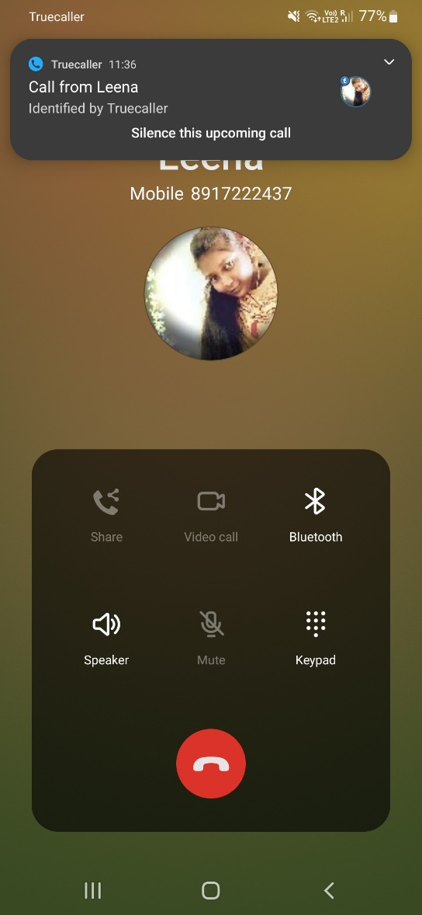
Assessment Page
Analysis Page
Thank you page
Doctor details Page
Dial page

Slide 10
Conclusion
Android is a software that is open source, which means that anyone can take the software and use it and it is also based on the operating system called Linux. It is used to make applications that are supposed to run on mobile gadgets that have screens of various sizes and the application adjusts accordingly to the varied sizes of the screens. Android helps in development of applications and the applications so developed can be uploaded on Google Play Store and the everyone will be able to use the application.
The stress can cause various health problem in body. And it’s needed to be cured before it gets dangerous. This app helps to guide user completely and help them to find path through out the journey. It is easy for user to have a handy app to check their mental health often.

Slide 11
thank you

